Slide 1

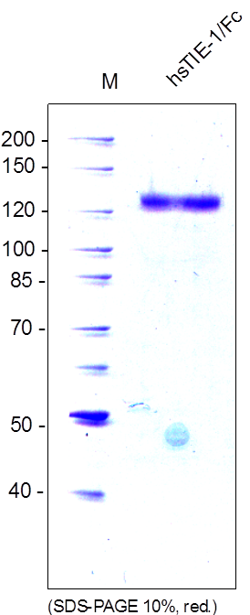
Reliatech GmbH
Mouse soluble TIE1-Fc Chimera (CHO cells)
(Cat# SFC-031 / SFC-032))
Figure 1: SDS-PAGE analysis of recombinant mouse sTIE-1/Fc Chimera produced in CHO cells. Sample was loaded in 10% SDS-polyacrylamide gel under reducing conditions and stained with Coomassie blue.
http://www.reliatech.de / orders@reliatech.de

